Slide 1

E-Commerce Business Intelligence Dashboard report
Power BI Dashboard Analysis
By - Purva Dhongadi

Slide 2
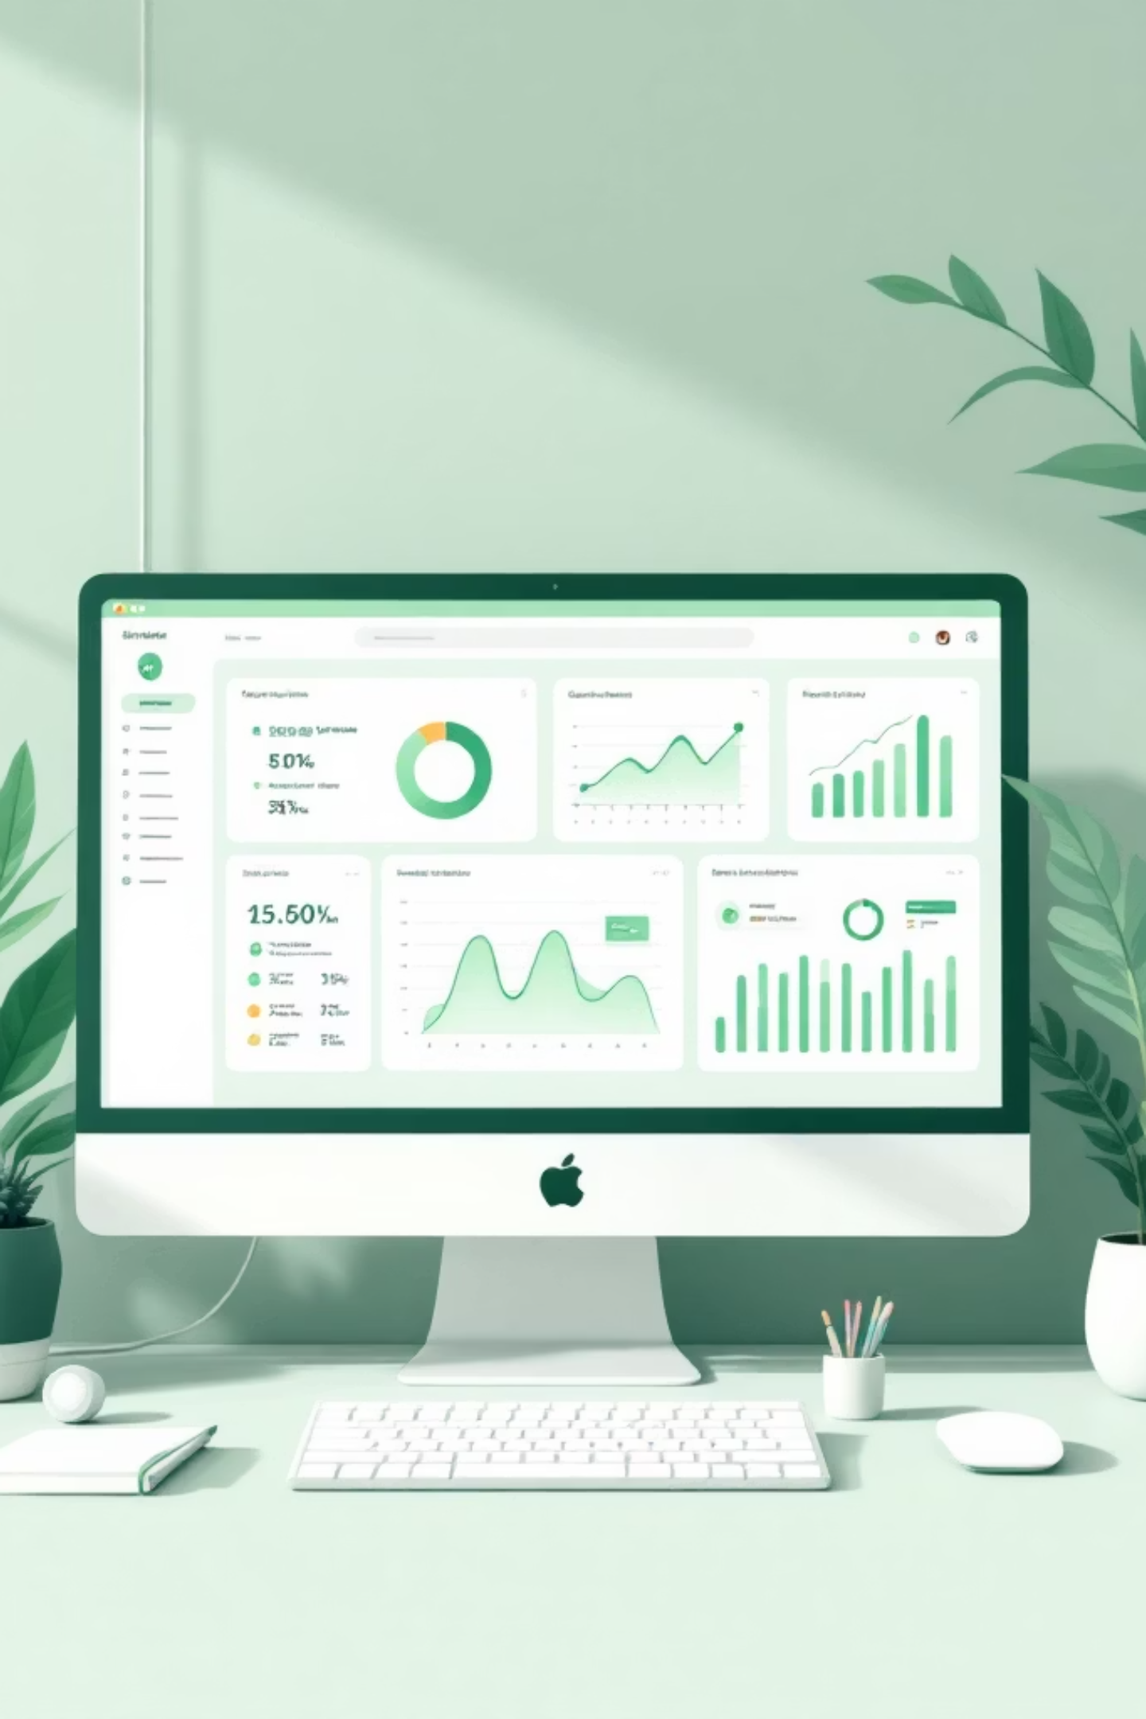
Understanding Our Dashboard
A comprehensive Power BI dashboard designed to transform e-commerce data into actionable business insights. This tool analyzes four critical business dimensions: sales performance, profitability metrics, customer behavior patterns, and product performance.
By centralizing key metrics and trends in a single interactive interface, decision-makers can quickly identify opportunities, assess challenges, and track progress toward business objectives. Real-time connectivity allows for immediate data exploration and scenario analysis.

Slide 3





Core Dashboard Objectives
Monitor Sales & Revenue
Track Profit & Costs
Understand Customers
Track total sales and revenue trends across all channels and product lines
Analyze profit margins and cost structures to identify optimization opportunities
Study purchasing patterns and behavioral trends to inform marketing strategies
Identify Top Products
Evaluate Regions
Determine which categories and SKUs drive the highest revenue and margins
Compare performance across geographic markets and distribution channels

Slide 4
Critical KPIs Tracked
These metrics provide a comprehensive view of business health and performance:
2.4M
315K
Total Sales Revenue
Total Profit
Quarterly revenue across all product categories
Net profit after all costs and expenses
8,437
284
Total Orders
Average Order Value
Number of completed transactions in period
Mean revenue per customer transaction
6,291
13.2%
Customer Count
Profit Margin
Unique buyers in reporting period
Percentage of revenue remaining as profit

Slide 5

Sales Performance Analysis
Trend Insights
Monthly and year-over-year revenue patterns reveal seasonal demand cycles and growth trajectories. Visualization tools highlight peak shopping periods, enabling proactive inventory planning.
Pattern Recognition
Q4 holiday surge: 45% above average
Q2 steady growth: consistent 8% monthly increase
Identification of low-performing months requiring strategy adjustments
Impact analysis of promotional campaigns on revenue lift

Slide 6
Profit Analysis Deep Dive
Revenue vs. Profit Comparison
Low-Margin Product Identification
Analyze the gap between gross sales and net profit, identifying cost pressures and efficiency opportunities across the business.
Flag SKUs with profit margins below target thresholds, enabling pricing adjustments, cost reductions, or strategic discontinuation decisions.
Discount Impact Assessment
Category Contribution Analysis
Measure the profitability effect of promotional pricing strategies, balancing volume increases against margin erosion to optimize discount programs.
Understand which product categories generate the highest profit returns, guiding resource allocation and product portfolio investment decisions.

Slide 7




Product Performance Insights
Categorize products by performance tier to guide inventory and marketing strategies.
Top-Selling Products
Highest-Margin Categories
Low-Performing Items
Inventory Optimization
Identify consistently high-revenue SKUs that drive traffic and conversion rates across channels
Flag products requiring strategy changes through price adjustments, promotions, or strategic discontinuation
Determine which product lines deliver superior profitability relative to capital investment and inventory requirements
Balance stock levels with demand forecasts to minimize holding costs while preventing stockouts

Slide 8

Customer Analysis & Segmentation
01
Customer Classification
Distinguish repeat purchasers from new customers to measure loyalty and acquisition effectiveness
02
Segmentation Strategy
Group buyers by purchase value, frequency, and product preferences to tailor marketing messages and offers
03
Order Value Tracking
Monitor average order value trends to identify upselling opportunities and cart abandonment triggers
04
High-Value Identification
Flag top-tier customers for VIP programs and retention initiatives to maximize lifetime value

Slide 9

Actionable Business Recommendations
Strategic Focus Areas
Implementation priorities with estimated timelines and required resources:
Product Marketing: Allocate 20% more budget to top 3 product lines (4-week rollout)
Regional Strategy: Deploy regional manager for underperforming area (6-week hiring timeline)
Pricing Optimization: Review margins on 15 low-performing SKUs (2-week analysis period)
Loyalty Program: Develop tier system with exclusive offers for top 10% customers (8-week development)
Discount Management: Cap promotional spending at 15% of revenue (immediate policy enforcement)

Slide 10
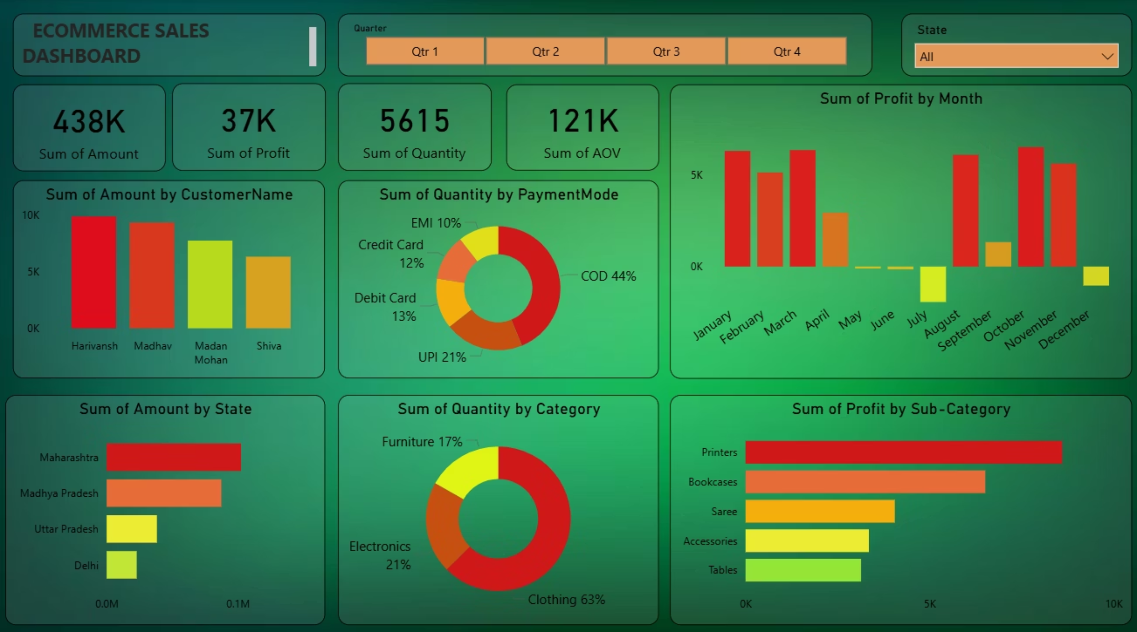
Ecommerce Sales Dashboard

Slide 11

Key Takeaways
The E-Commerce Business Intelligence Dashboard empowers stakeholders to make faster, more informed decisions—from inventory planning to marketing optimization.
Comprehensive Insights
Five critical business dimensions monitored in single interface: sales, profit, customers, products, and regions
Strategic Foundation
Actionable metrics inform both long-term strategic moves and day-to-day operational adjustments
Performance Tracking
Real-time KPI visibility enables rapid response to market changes and competitive threats
Growth Enablement
Efficiency gains through optimized resource allocation across products, categories, and geographic markets

Slide 12




Conclusion
A powerful dashboard driving informed action and continuous improvement across your e-commerce operations.
Comprehensive Insights
Strategic Decision-Making
Gain a complete understanding of business performance through integrated data views and advanced analytics.
Empower leaders to make data-driven choices for future growth, market expansion, and daily operations.
Performance & Growth
Enhanced Efficiency
Continuously track key performance indicators, identify emerging trends, and plan for sustainable expansion.
Optimize processes, reduce operational costs, and improve resource allocation across all departments.

